Slide 1




Other Real-World Examples

Slide 2

Evaluation of NC STOP act-mandated acute and post-surgical opioid prescribing limits
PI: Ranapurwala; Co-I: Wu (Duke), Edwards (Vanderbilt) [CDC R01]
STOP act mandate: Opioid prescribing limits for acute (< 5 days) & post-surgical (< 7 days) pain
Physician’s opioid prescribing behavior
Intended prescribing
Opioid naïve acute and
post-surgical pain patient
Reduction in Long-term OPR use, OUD, OOD
Unintended prescribing
Opioid exposed acute and post-surgical pain patient
Inappropriate tapering
Discontinuation

Slide 3





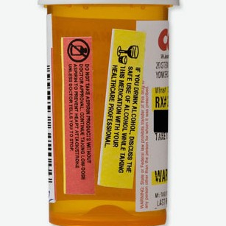



EHR
PDMP
Mortality

Slide 4
Decline in mean opioid days’ supply in new opioid users
NC: 2006-2018
State
medical
board
investigative
initiative
Legislation
to limit initial
opioid prescriptions
Voluntary
PDMP
ACA
trend change:
-1.5 (-2.0, -1.1)
trend change:
-2.2 (-2.7, -1.7)
*Maierhofer CN, Ranapurwala SI, DiPrete BL, Fulcher N, Ringwalt CL, Chelminski PR, Ives TJ, Dasgupta N, Go VF, Pence BW. Association between state policies and opioid prescribing patterns in North Carolina, 2006–2018. Pain Med. 2021 Dec 11;22(12):2931-2940. doi: 10.1093/pm/pnab181.

Slide 5
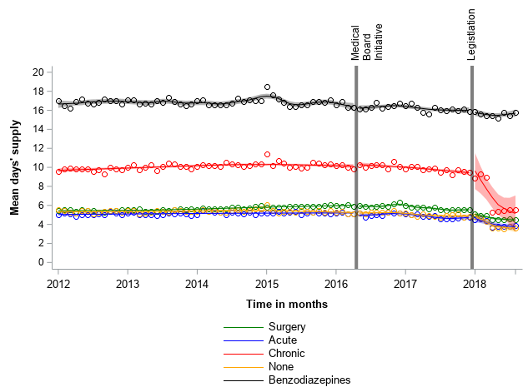
But are the changes in the mean opioid days’ supply in new opioid users unintended? NC: 2012 – 2018
State
medical
board
investigative
initiative
Legislation
to limit initial
opioid prescriptions
*Maierhofer CN, Ranapurwala SI, DiPrete BL, Fulcher N, Ringwalt CL, Chelminski PR, Ives TJ, Dasgupta N, Go VF, Pence BW. Intended and unintended consequences: Changes in opioid prescribing practices following two policies in North Carolina, 2012–2018 – A controlled interrupted time series analysis. (under review)

Slide 6

Association of NC Safe Opioid Prescribing Initiative (SOPI) with opioid prescribing in NC (CDC funded R49: UNC Injury Prevention Research Center; PI: Marshall; Project lead: Ranapurwala)
SOPI: Investigate prescribers; sent letters (April 2016)
Prescription monitoring program data from NC: 2010-2017
High dose long term opioid therapy (HD-LTOT) patients: receiving >=90MME for at least 90 days
Rapid tapering: > 10% MME drop per week for two weeks
Discontinuation: Complete stoppage for 30 days
Controlled interrupted time series analyses
Ranapurwala SI, Ringwalt CL, Pence BW, Schiro S, Fulcher N, DiPrete BL, Marshall SW. State Medical Board Policy and Opioid Prescribing: A Controlled Interrupted Time Series. Am J Prev Med. 2021 Mar;60(3):343-351.

Slide 7
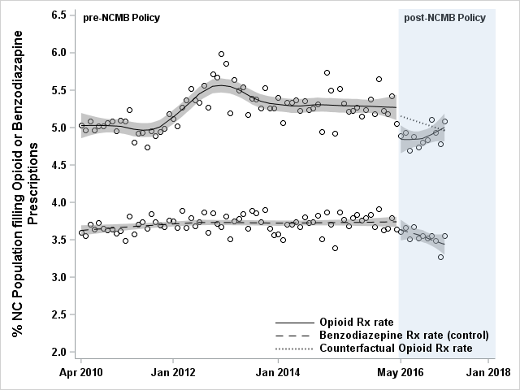
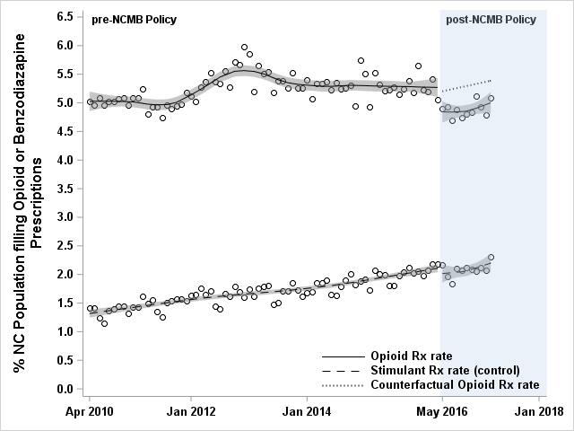

Slide 8
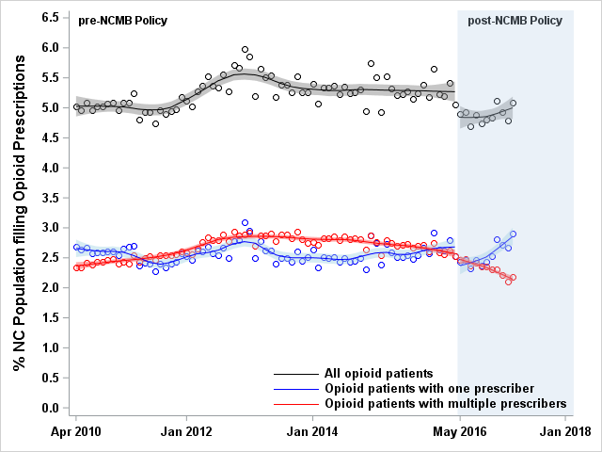
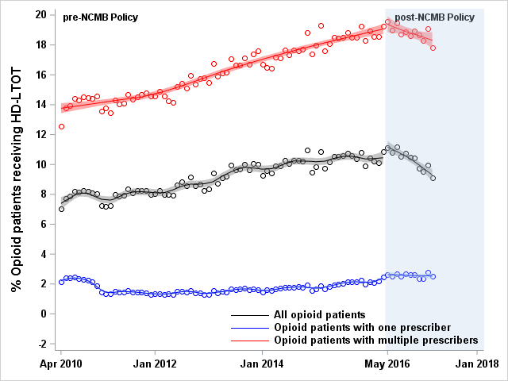

Slide 9
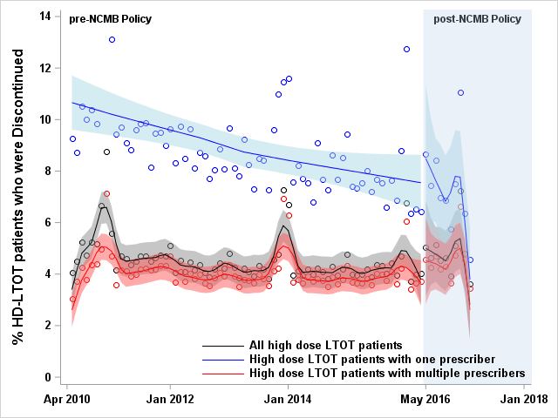
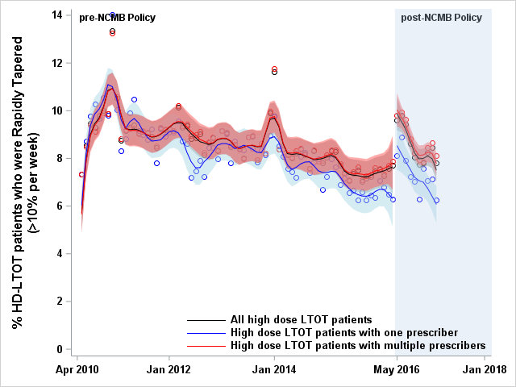
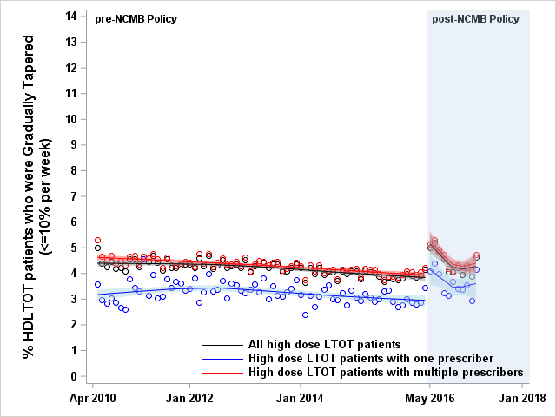

Slide 10
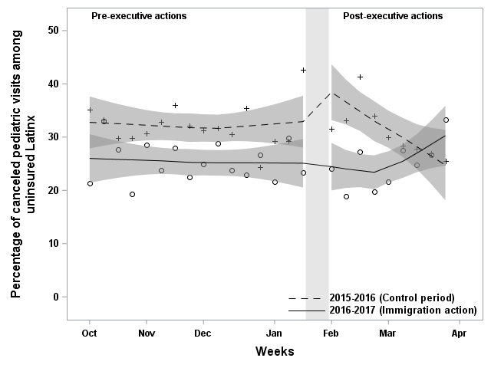
Health Care Use Among Latinx Children After 2017 Executive Actions on Immigration
Cholera R, Ranapurwala SI, Linton J, Shmuel S, Miller-Fitzwater A, Best DL, Simha S, Flower KB. Health Care Use Among Latinx Children After 2017 Executive Actions on Immigration. Pediatrics. 2021 Feb;147(2):e20200272. doi: 10.1542/peds.2020-0272.

Slide 11
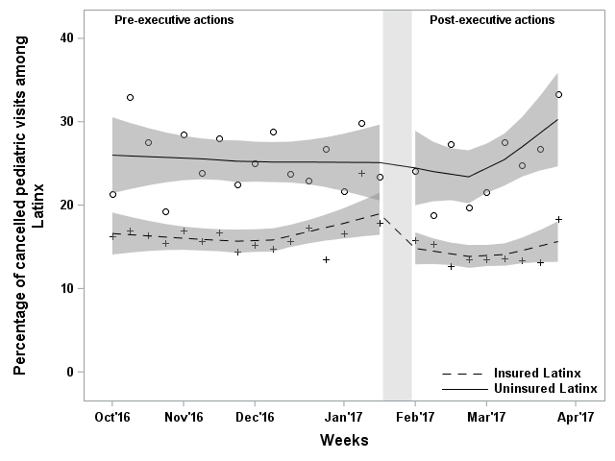
Health Care Use Among Latinx Children After 2017 Executive Actions on Immigration
Cholera R, Ranapurwala SI, Linton J, Shmuel S, Miller-Fitzwater A, Best DL, Simha S, Flower KB. Health Care Use Among Latinx Children After 2017 Executive Actions on Immigration. Pediatrics. 2021 Feb;147(2):e20200272. doi: 10.1542/peds.2020-0272.

